Slide 1
1516 Lesson 2
Functions, DocStrings, Modules

Slide 2
Lesson 2 Learning Outcomes
Functions
Flow of Control
Comments and DocString
Modules
Arithmetic Operators
Assignment Operator
main Function
main guard

Slide 3
Functions
A function is an instruction. Python has a number of built-in functions:
print()
input()
type()
str()
etc...
As software developers, our job is create our own functions (also known as methods, procedures, or subroutines).

Slide 4
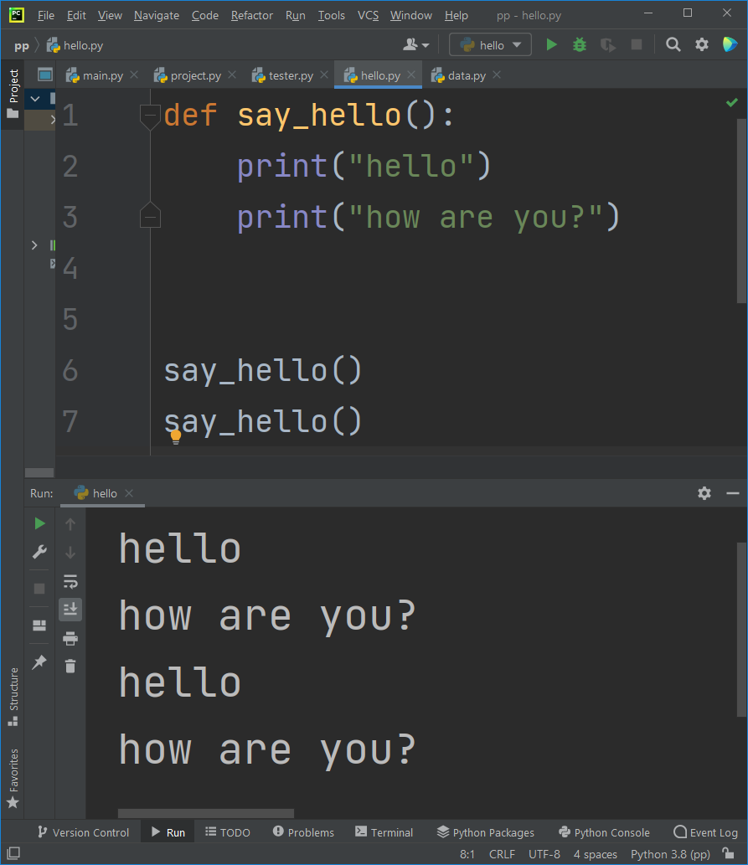
Defining a Function
We use the def keyword to define our own functions.
Functions can be very simple, like this:
def say_hello():
print("hello")
print("how are you?")
say_hello()
say_hello()
One a function has been defined, it may be used never, or once, or many times.
The first three lines above "define" (or "implement") the say_hello function.
The last two lines "call" (or "invoke") the say_hello function. Here, we decided to call it two times.

Slide 5
Rules to Define a Function
Notice the rules when defining our own Python functions:
1. use the "def" keyword
2. give your new function a name; almost always use a verb, and avoid Python's keywords (e.g. don't try to name your function "print")
3. put parentheses ()
4. put a colon
5. indent all the code inside your function; 4 spaces each line is typical

Slide 6
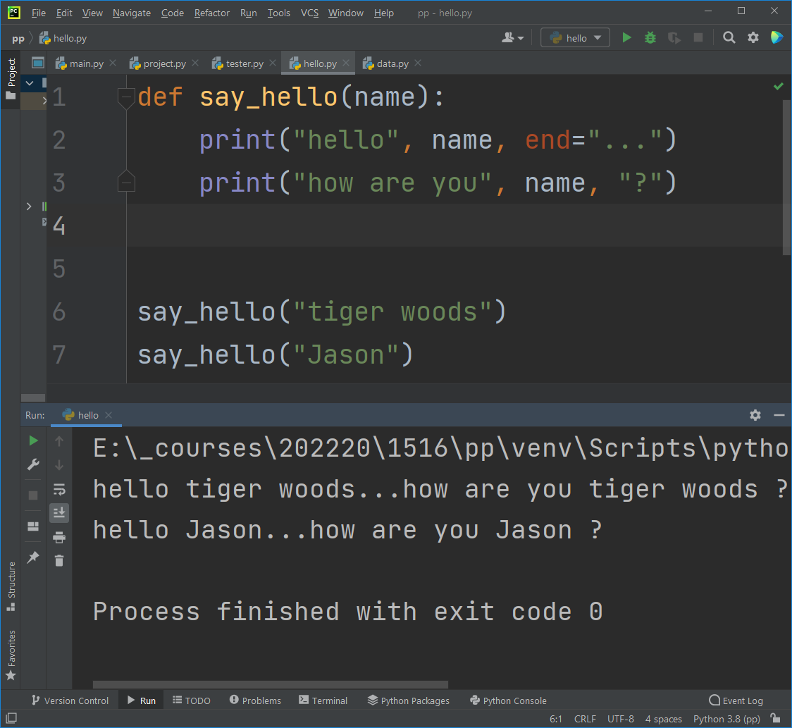
Function Arguments
The parentheses can be empty, or they can have variables.
These variables are the function's inputs, called “arguments” or “parameters”
def say_hello(name):
print("hello", name)
print("how are you", name, "?")
say_hello("tiger woods")
say_hello("Jason")

Slide 7
Function Outputs
Now that we know how to give inputs to functions, let’s learn about outputs.
A function can have zero, one, or many arguments (inputs):
def say_hello():
def say_hello(name):
def say_hello(first_name, last_name):
A function may also have zero or one outputs by using “return”

Slide 8
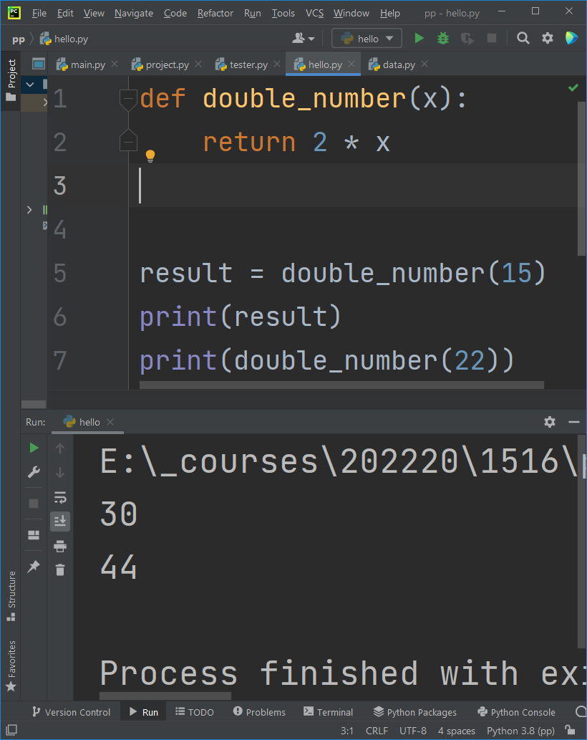
Function Outputs
A “return” statement is optional inside a function.
“return” gives a value to whoever called the function.
“return” is not the same as print().
When we call a function, its return value can be printed, or put into a variable

Slide 9
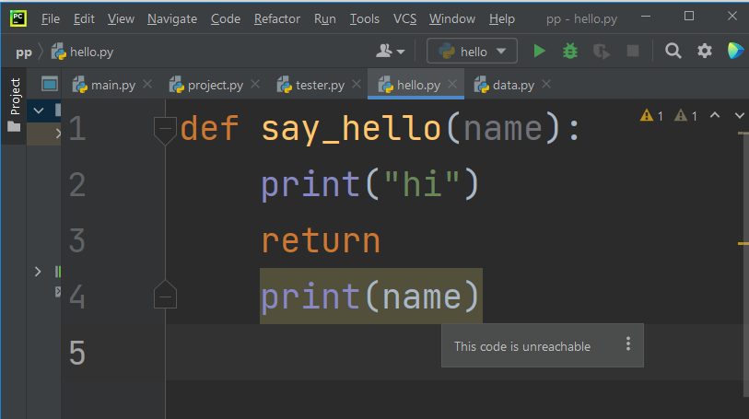
return
Your function may return a value (see previous slide), or it may simply say “return” (see this slide), which returns the value None.
Whenever a function sees “return”, it immediately stops the function from running, and it immediately gives the returned value to the caller.
You cannot continue code after a function has returned. It’s over. It’s finished.

Slide 10
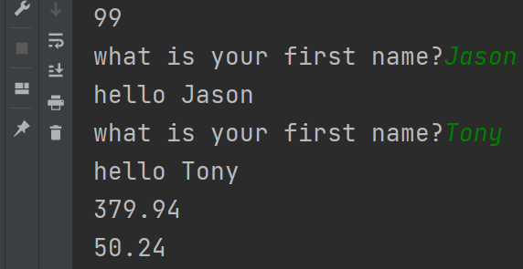
Function Examples
def triple(num):
return 3 * num
def greet_user():
first_name = input("what is your first name?")
print("hello", first_name)
def get_circle_area(radius):
return 3.14 * radius ** 2
answer = triple(33)
print(answer)
greet_user()
greet_user()
print(get_circle_area(11))
print(get_circle_area(4))

Slide 11
DocString
A DocString is a more formal comment type, used in functions
It has several parts:
Triple quotation marks
A full sentence explaining the function’s purpose
Explanations in plain language of what each argument is
Explanation in plain language of what the function returns
Use DocString comments for every function you write.
See the next slide, which improves the previous slide’s code.

Slide 12
Function Examples
def triple(num):
"""Takes in a number and returns its triple.
:param num: the number to be tripled
:return: the tripled version
"""
return 3 * num
def greet_user():
"""Asks the user their name, and then tells them hello.
:return: None
"""
first_name = input("what is your first name?")
print("hello", first_name)
def get_circle_area(radius):
"""Calculates and returns the area of the circle with a given radius.
:param radius: the radius of the circle
:return: the area of the circle
"""
return 3.14 * radius ** 2

Slide 13
pass
Sometimes we need to write a lot of functions, but don’t have the time or information needed right now to do it.
Use the keyword pass to tell Python “I will fill this in later…just don’t complain that I have an empty function. Leave me alone.”
Without pass, Python dislikes an empty function.
See next slide for the difference.

Slide 14
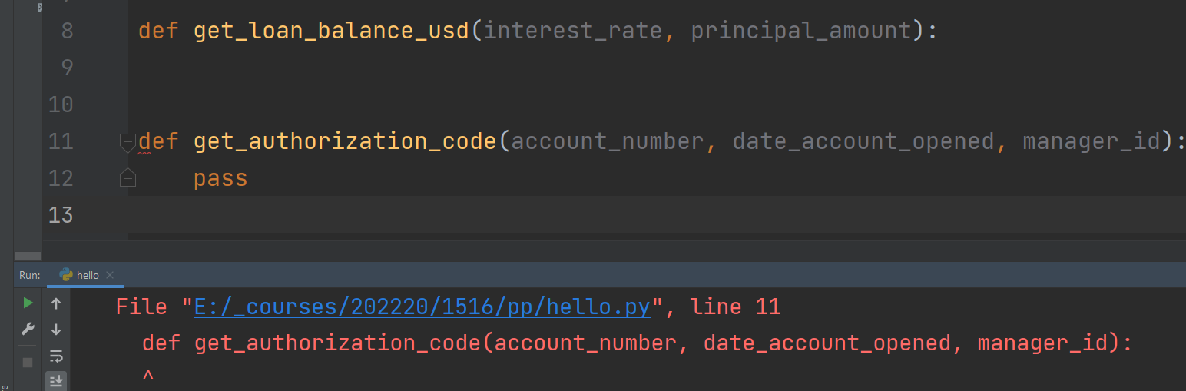
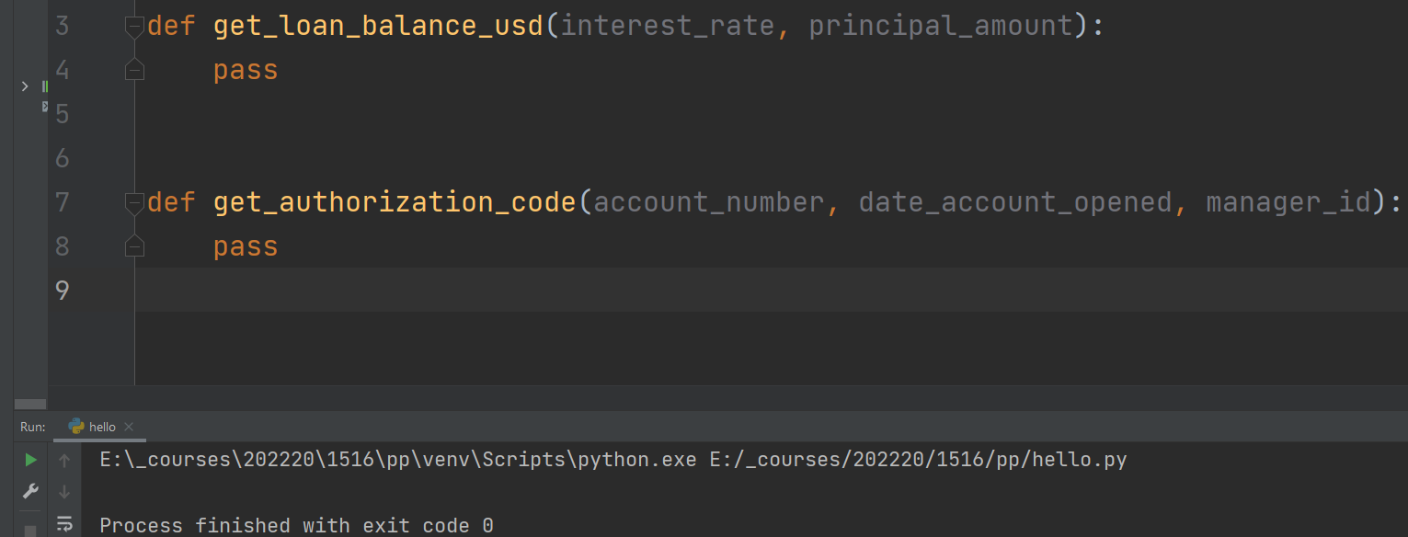
pass

Slide 15
Module vs. Script
We store our code in Python files.
A file can be considered either a module or a script.
A module is nothing but a collection of functions. Nothing is running.
A module can be imported by other files, and the functions can be executed in that other file.
A script is a Python file that has executing code. It often imports code from modules.
See next slide.

Slide 16
Module vs. Script: importing
Module: my_stuff.py
Script: running_code.py
def triple(num):
"""Takes in a number and returns its triple.
:param num: the number to be tripled
:return: the tripled version
"""
return 3 * num
def get_loan_balance_usd(interest_rate, principal_amount):
pass
def greet_user():
"""Asks the user their name, and then tells them hello.
:return: None
"""
first_name = input("what is your first name?")
print("hello", first_name)
def get_circle_area(radius):
"""Calculates and returns the area of the circle with a given radius.
:param radius: the radius of the circle
:return: the area of the circle
"""
return 3.14 * radius ** 2
from my_stuff import * # not good
answer = triple(33)
from my_stuff import triple # ok
answer = triple(33)
import my_stuff # great
answer = mystuff.triple(33)

Slide 17
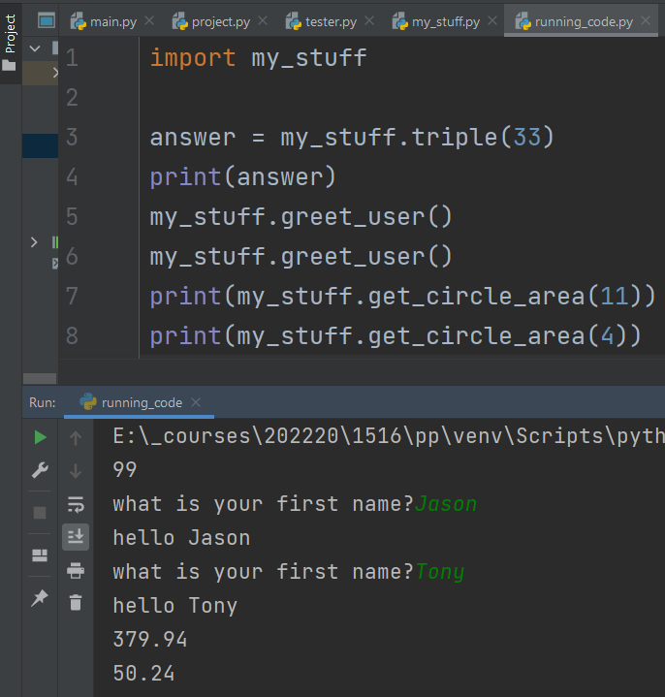
importing

Slide 18
Best Practices
Separate each function from other functions by two blank lines.
End each file with a blank line.
Import modules as in the previous two slides.
Indent function code four spaces.

Slide 19
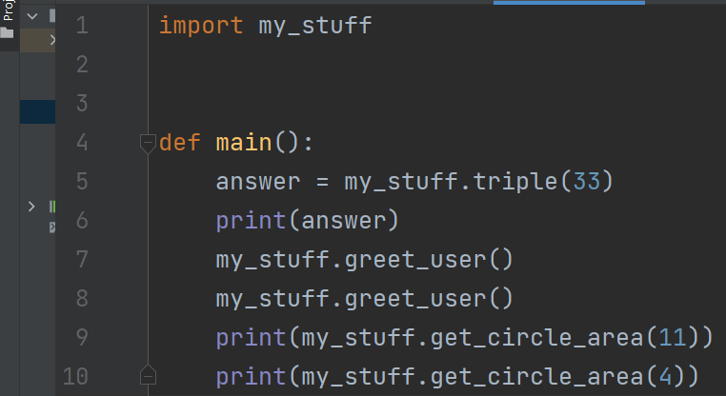
main
In many programming languages, including Python, the computer will search for a function named main()
The main function is the entry point for the program, to begin running there
We should put our code into functions like that, rather than having code simply sitting inside a file

Slide 20
Calling main
Now we have created a main function, but it is not yet being called anywhere!
However, we want main to be called only for scripts.
We do not want a module’s main function to be triggered when that module is imported!
To make sure only a running script has its main function called, we put in something called a main guard.

Slide 21
main Guard
Comparison:
We can end our file with one of two choices:
1. main()
2. if __name__ == "__main__":
main()
If we used #1, then main() is called all the time, even if this file is simply being imported.
If we use #2, then Python will ask itself “is this file being imported right now? If so, don’t call main(). But do call main if this file is actually being executed.”
Use method #2.
import my_stuff
def main():
answer = my_stuff.triple(33)
print(answer)
my_stuff.greet_user()
my_stuff.greet_user()
print(my_stuff.get_circle_area(11))
print(my_stuff.get_circle_area(4))
if __name__ == "__main__":
main()

Slide 22
imports
We will import other modules soon too
Python has useful built-in modules for a large variety of tasks

Slide 23
Random Useful Tidbits
Strings and Prints, etc
print(5 + 5) # 5 plus 5 equals 10
print("hi” + "bye") # "hi" joined with "bye" equals "hibye"
print("hi” + 7) # cannot join str to int; Error
print("hi" + str(7)) # "hi" joined with "7" equals "hi7”
print("a".upper()) # A
print(5.upper()) # CRASH; only strings have upper() ability
print("5".upper()) # 5
print(str(5).upper()) # 5
Recall from the previous session arithmetic operators (+, -,*,/,//,**) were discussed.
In Python, the % operator is called the modulus (“mod”) operator, used to calculate the remainder after division
Example:
100 = 12 * 8, remainder 4
100 // 12 = 8 # integer division
100 % 12 = 4 # remainder

Slide 24
Random Useful Tidbits
Operator Precedence:
Example:
10 – 4 * 2 = 2 because the multiplication will be executed before the subtraction
4 * 2 = 8 and then 10 – 8 = 2
Make it clearer! 10 - (4 * 2) Add in parentheses for clarity and/or to change the order of operations
(10 – 4) * 2 = 12 with the parentheses the subtraction will be executed before the multiplication
10 – 4 = 6 and then 6 * 2 = 12
With the parentheses the order of operation is:
x = 6
x+=5 # x is now 11
x-=2 # x is now 9
x//=4 # do not do this; too complex
x = x // 4 # Instead, do this
If you’re writing a novel, your job is to be clear. Do not make your readers check a thesaurus or dictionary for every word. Be simple. Be clear.
Operator | Meaning
() | Parentheses
** | Exponent
* , / , // , % | Multiplication, Division, Floor Division, modulus
+ , - | Addition, Subtraction

